Slide 1
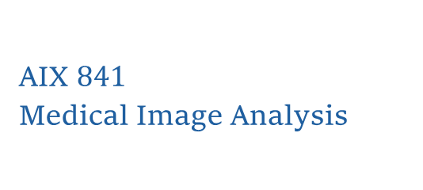
Introduction to the Course
AIX $841$
Medical Image Analysis
Prof. Sushree S. Behera

Slide 2
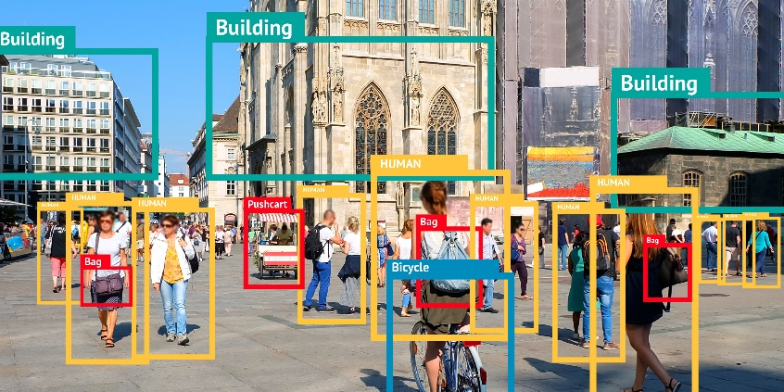
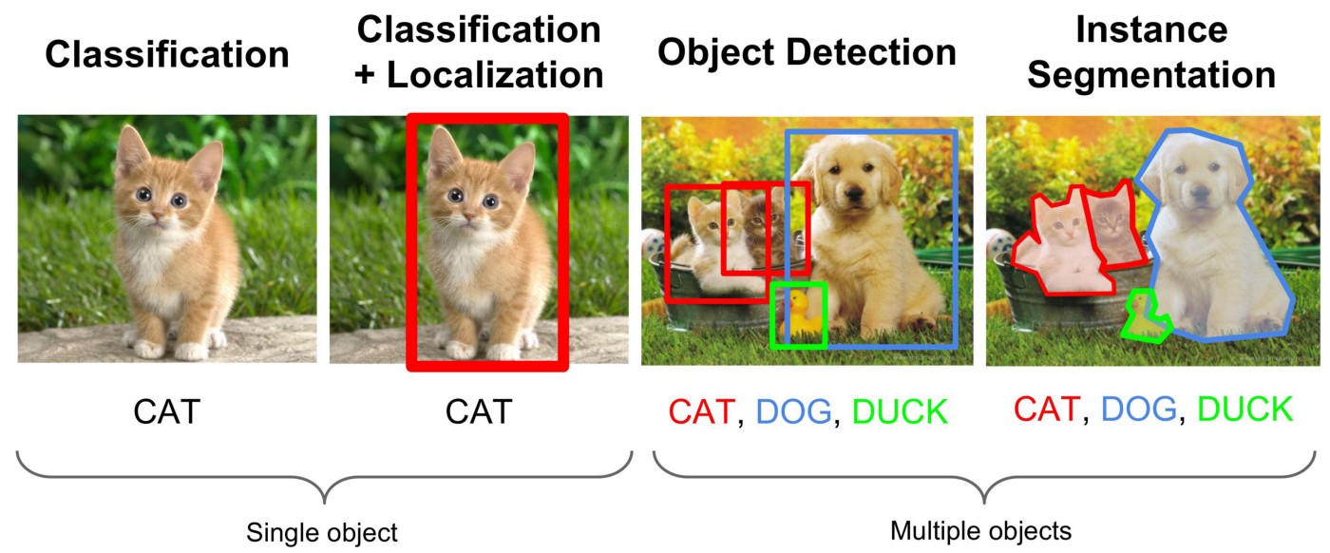
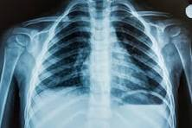
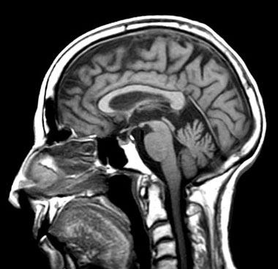
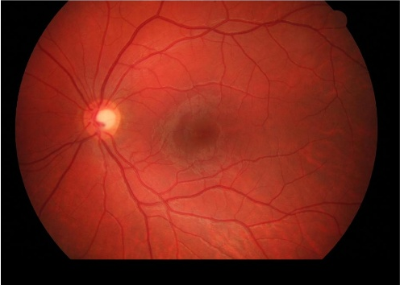
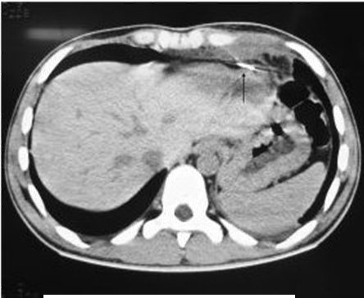
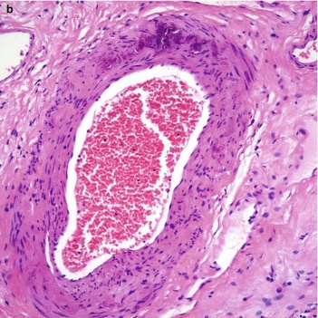
Medical Images
General images and medical domain images - comparison of spatial characteristics
https://www.google.com/
https://www.google.co.in/
Notes:
Unlike general images, medical images exhibit different spatial characteristics, and the regions of interest often lack clear boundaries with the background. Therefore, the direct application of conventional computer vision methods is not effective. Instead, it becomes necessary to employ modality-specific pre-processing steps and tailored feature extraction techniques to address these challenges accurately.

Slide 3
Medical Image Analysis
Use of automated computer algorithms to extract meaningful information from medical images.
AI-powered medical image analysis offers:
Improved accuracy
Enhanced speed
Increased efficiency
Personalized medicine
AI and human expertise synergize to advance medical imaging.
Notes:
Medical image analysis involves the use of automated computer algorithms to extract meaningful information from medical images. AI-powered medical image analysis has transformed the field of disease diagnosis and treatment planning, offering numerous benefits:
AI algorithms can analyze medical images with a high degree of accuracy, reducing the likelihood of error.
AI-powered image analysis can process medical images at much higher speed, enabling rapid diagnosis and treatment.
AI can automate routine tasks, freeing up radiologists and clinicians to focus on more complex and high-value tasks.
AI can help tailor treatment plans to individual patients, taking into account their unique medical history, genetic profile, and lifestyle factors.

Slide 4
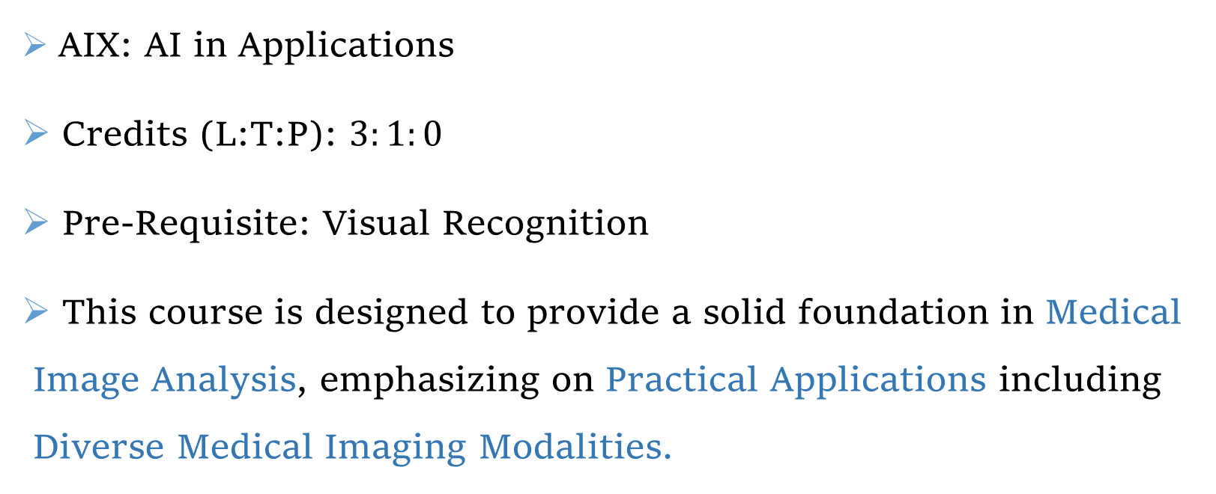
Course Details
AIX: AI in Applications
Credits (L:T:P): $3:1:0$
Pre-Requisite: Visual Recognition
This course is designed to provide a solid foundation in Medical Image Analysis, emphasizing on Practical Applications including Diverse Medical Imaging Modalities.

Slide 5
Course Content
Introduction to Different Medical Imaging Modalities
Modality-specific Pre-processing and Feature Extraction
Image Segmentation applied to Medical Domain
Anomaly Detection and Classification from Medical Images
Advanced Topics
Case-studies, Current Advancements and Future Research Directions

Slide 6
Course Content (Contd.)
Introduction to Different Medical Imaging Modalities
Radiology
Ultrasound
MRI
Pathology
RGB images
Multi-modal and so on

Slide 7
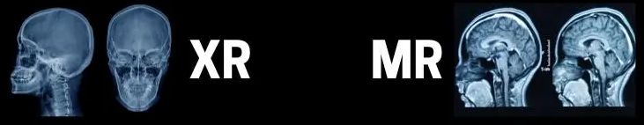
Course Content (Contd.)
Modality-specific Pre-processing and Feature Extraction
Different imaging modalities have unique characteristics and artifacts.
Each imaging modality captures different types of information (e.g., MRI: soft tissue contrast, X-ray: bone structure)
MRI Images
X-ray Images
https://www.medicalimagingsource.com/mri-vs-x-ray-whats-the-difference

Slide 8
Course Content (Contd.)
Image Segmentation applied to Medical Domain
U-Net and beyond
Anomaly Detection and Classification from Medical Images
Convolutional neural networks and Transformers

Slide 9
Course Content (Contd.)
Advanced Topics
Applications with Multi-modal Data
Image and Clinical Dara
Image and Bio-markers
Case-studies, Current Advancements, and Future Research Directions

Slide 10
Course Content (Contd.)
Pre-processing of Medical Images
Regions of Interest Segmentation from Medical Images
PC3
Introduction to Different Medical Imaging Modalities
PC1
PC2
Feature Extraction from Medical Images
Anomaly Detection and Recognition from Medical Images
PC4
X-ray
Pathology
MRI
PC1: Study of various medical imaging modalities
PC2: Pre-processing and feature extraction from medical images
PC3: Segment regions of interests from medical images
PC4: Detect and classify anomalies from medical images
Ultrasound
and so on
PC: Project Component
Notes:
The Class Project will comprise four components, each involving group-based coding assignments and presentations. Each group will focus on a specific medical imaging modality, allowing students to develop hands-on expertise in targeted areas.

Slide 11
Assessment Plan
Attendance and Class Participation: 5%
Assignments: 10% [Research Paper Presentation]
Mid-term Examination: 20%
End-term Examination: 25%
Class Project: 40% [Modality-specific Project Component]

Slide 12
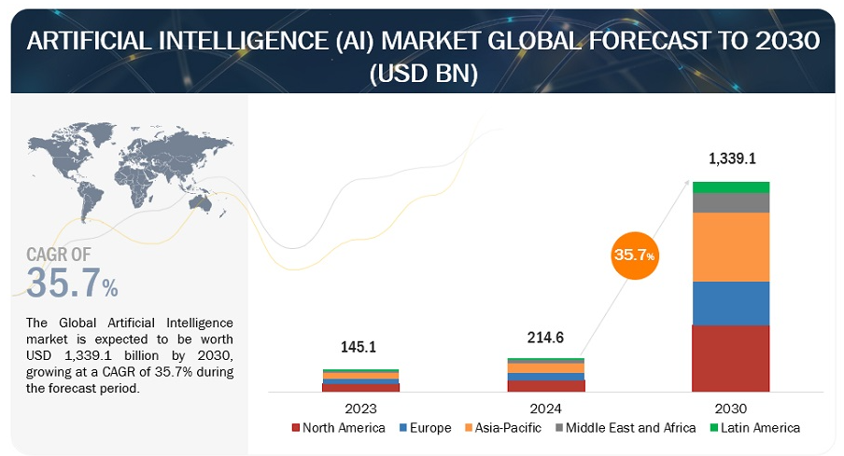
Market Scenario and Career Opportunities
https://www.marketsandmarkets.com/Market-Reports/artificial-intelligence-market-74851580.html
Notes:
The significant upward trajectory of global AI market is fueled by advances in computational capabilities and the growing availability of data. Governments worldwide, especially in the Asia Pacific region, are making substantial investments in AI research and development, creating a supportive ecosystem for innovation.

Slide 13
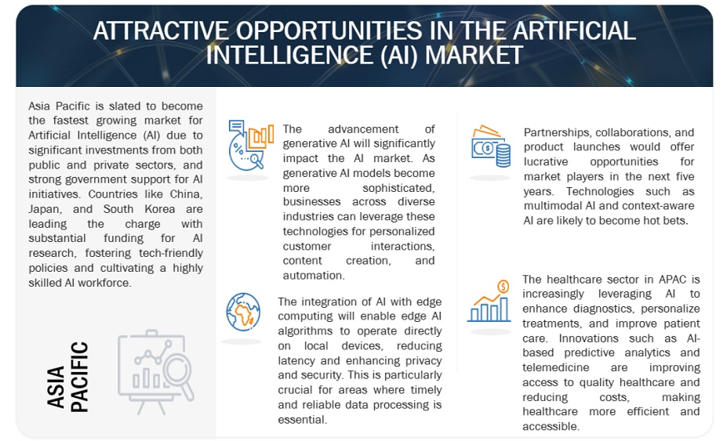
Market Scenario and Career Opportunities
https://www.marketsandmarkets.com/Market-Reports/artificial-intelligence-market-74851580.html
Notes:
Innovations such as AI-based predictive analytics and telemedicine are improving access to quality healthcare and reducing costs, making healthcare more efficient and accessible.

Slide 14
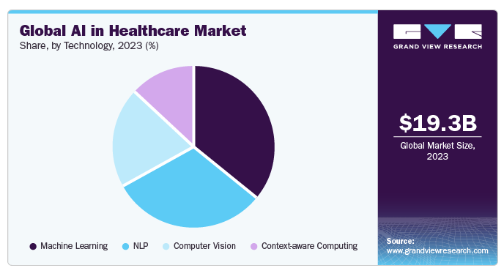
Market Scenario And Career Opportunities
AI-driven predictive analytics
Telemedicine
https://www.grandviewresearch.com/industry-analysis/artificial-intelligence-ai-healthcare-market

Slide 15
Computer Vision
Computer Vision Techniques Applied to General Images
Well-defined boundary between the object and background
Straightforward application
https://www.google.com/
Notes:
In general-purpose images, the boundary between the object of interest and the background is often well-defined, making tasks such as classification and detection relatively straightforward.

Slide 16
Computer Vision
Low Level Process
Mid Level Process
High Level Process
Input: Image Output: Image
Examples: Noise removal, image sharpening
Input: Image Output: Attributes
Examples: Object recognition, segmentation
Input: Attributes Output: Understanding
Examples: Scene understanding, autonomous navigation, decision-making
Three Levels Processing in Computer Vision Systems
https://www.google.com/
Notes:
Low-level processing involves both input and output in the form of images. It includes basic operations such as noise reduction, image enhancement, and filtering. Mid-level processing takes an image as input and produces intermediate representations such as features or regions of interest. Examples include object recognition and image segmentation. High-level processing uses the extracted features or attributes to generate a deeper semantic understanding of the scene. Applications in this category include scene interpretation, autonomous navigation, and decision-making systems.

Slide 17
Medical Image Analysis
Disease Diagnosis
Disease Classification
Anomaly Detection
Region of Interest Segmentation

Slide 18
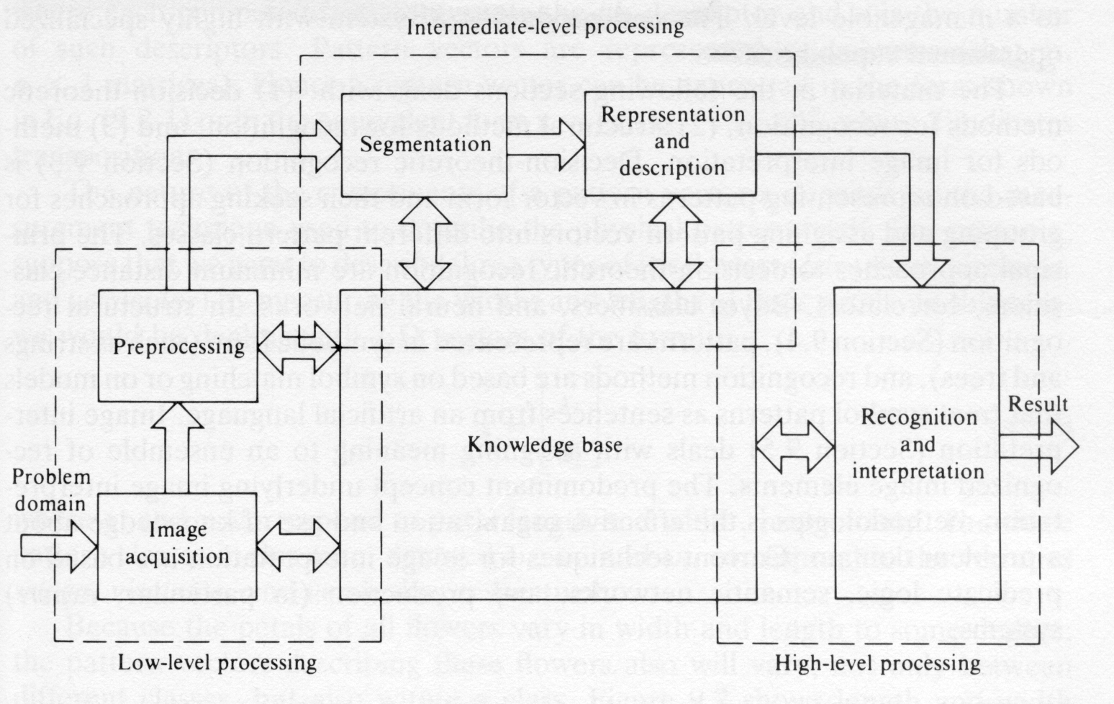
Medical Image Analysis
Key Levels of Medical Image Analysis

Slide 19
Medical Image Analysis
Modalities
Physics
Image formation
Machine Learning
Classification
Image Processing
Denoising
X-ray, CT Scan
MRI
Ultrasound
Pathology
Tissue-energy Interaction
Medical Imaging
Segmentation
Enhancement
Detection
Reasoning
Notes:
Medical image analysis has a holistic structure. It consists of four different quadrants.
Medical Imaging: How different organs are going to appear in different modalities whether in a healthy state or in a disease state.
Physics: Why different organs appear differently in these modalities.
Image Processing: Raw medical data often contains noise and may suffer from low quality, which necessitates preprocessing to enhance image clarity and usability.
Machine Learning: Based on the nature of the problem, we will apply a range of machine learning and computer vision methods to medical image data. Typical tasks include classification, recognition, anomaly detection, and region-based analysis, among others.

Slide 20
Resources
Zhou, S.K. and Greenspan, H. and Shen, D. Deep Learning for Medical Image Analysis, The MICCAI Society Book Series, Elsevier Science, 2017.
Frangi, A. and Prince, J. and Sonka, M. Medical Image Analysis, The MICCAI Society Book Series, Elsevier Science, 2023.
Gonzalez, Rafael C. Digital image processing. Pearson Education India, 2009.
Medical Image Analysis, NPTEL, by Prof. Debdoot Sheet, IIT Kharagpur http://www.youtube.com/@medicalimageanalysis9258
Medical Image Analysis, NPTEL, by Prof. Ganapathy Krishnamurthi, IIT Madras https://youtu.be/TpPXxJ7fPDs?si=kbNBNWvVc-zyE0RF

Slide 21
Thank You

